Slide 1
Documenting in the EHR as a Medical Student

Slide 2
Introduction
Welcome to Application Phase!
We are so excited you are here and UNC is committed to making your medical education experience the best it can be!
As part of this commitment, we want to teach you to document effectively in the electronic health record
This will help you become an active health care team member and contribute to patient care

Slide 3
Introduction to the Clinical Setting
The primary reason medical students work in clinical settings is to prepare them to become well trained physicians
The clinical settings provide students with a real but closely supervised environment to acquire the knowledge, skills, and attitudes to succeed in residency and beyond
Documenting in the EHR as a non-licensed member of the treatment team is one such opportunity

Slide 4
Purpose of this Training
This presentation provides medical students with guidance on:
Rules medical students need to follow when documenting in the EHR as a non-licensed health professional student
Areas where students can help with documentation
Workflow students and supervising residents, attendings, and community physician preceptors should follow when writing notes
In this presentation, “teaching physician” refers to supervising residents, attendings, and community physician preceptors

Slide 5
A few notes to start
You will work with resident and attending physicians in the inpatient and outpatient settings. This training applies to work you will be doing with both residents and attending physicians who are teaching you
What you will learn in this presentation applies to both inpatient and outpatient settings at UNC including the Physicians Network (PN) practices. It does not always apply to settings outside the UNC system. These settings may have different policies related to student documentation

Slide 6
Part 1 Using the EHR for clinical care besides writing notes

Slide 7
What students can do in the ambulatory setting (with permission of the attending or resident)
Pend orders: Medical students may pend orders to be signed by an authorizing physician
Problem List and Medication History: The medical student may update the patient’s medication history and problem list. The medication history is updated in the Medication Tab within Epic@UNC.
Add/Update the PFSH and ROS: The medical student may add/update past, family, and social history and review of systems. The physician or APP is responsible for confirming this information and authenticating their note.
Transcribing External Test Results: The medical student may view and transcribe external test results in the “Enter/Edit Results” activity section of Epic@UNC to document a patient’s outside health maintenance records
Schedule: The medical student may update visit planning comments in the patient’s schedule
After Visit Summary: Medical students may participate in creating the patient “After Visit Summary”

Slide 8
What students can do in the inpatient setting (with permission of the attending or resident)
Pend orders: Medical students may pend orders to be signed by an authorizing physician
Facilitate Care Team Communication: Within the “Summary” activity section of Epic@UNC, the medical student may update their patient’s daily plan on the sign out list before leaving each day and add service-specific data to the sign out list.
Add/Update the PFSH and ROS: The medical student may add/update past, family, and social history and review of systems. The physician or APP is responsible for confirming this information and authenticating their note.
Problem List: Medical Students may update their patient’s problem list
Contribute to the Hospital Course: Within the “Discharge” activity tab, the medical student may contribute to the patient’s hospital course and keep this updated for their patients
Medication History: Within Epic@UNC, the medical student may use navigators to pend medication reconciliation for Admissions and Discharges on their inpatients

Slide 9
Part 2 Using the EHR to write notes

Slide 10
Make Meaningful Contributions
Medical students always want to feel helpful and needed by the medical team
By writing the note that will be a part of the legal medical record, you will be making an authentic contribution to the team
The attending or resident will appreciate your contributions to patient care
Helping with writing your patients’ notes in the EHR may free up the attending or resident’s time and allow for more teaching and education

Slide 11
Important things to remember
You must present your findings from the history, physical exam, and assessment/plan in the physical presence of the attending or resident. Ideally the patient should be present during the presentation as well
The attending or resident must verify in the medical record all student documentation or findings including the history, the physical exam, and/or medical decision making
The attending or resident must personally perform or re-perform the physical exam and medical decision making activities
The attending and resident must review and edit as necessary your note and attest that the attending or resident verified the information in the note

Slide 12
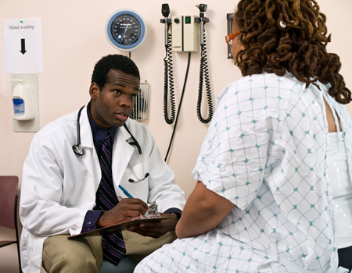
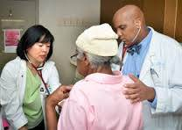
Step 1:
Student obtains H&P from patient
Step 2: Student presents to the attending or resident. The attending or resident verifies
Step 3: Student documents the encounter. The attending or resident edits the note so that only information verified is included and confirms that the note is verified. Student reads final note (for feedback)

Slide 13
Other considerations
Take documentation seriously. The attending or resident will review and edit your notes but you are still accountable for your documentation as a student
Communicate with the teaching physician if you have ANY question regarding a patient’s history, physical exam, plan or other aspects of the visit
Ask for feedback on notes you complete
Review the UNC Health Care policy “Medical Student Participation and Documentation in the EHR and Use of Medical Student Notes by Physicians and Advanced Practice Providers” PolicyStat ID # 4661931

Slide 14
Example – Clinical Case 1
Ambulatory Clinic Visit

Slide 15
Chart Review & Patient Visit
In the Application Phase, the student is assigned to see a patient at clinic presenting for an acute care visit with chief complaint of shortness of breath
The student reviews relevant information in the chart before entering the patient’s room
The student enters the room to interview a patient and obtains a history relevant to the patient’s complaint of shortness of breath. She performs a physical exam. She commits to a differential and management plan

Slide 16
Patient Presentation
She presents the patient’s history and physical exam, along with her assessment and plan, in the physical presence of the teaching physician (ideally in front of the patient)
The teaching physician makes it clear to the patient that the student is still learning and gives her feedback on her presentation
The teaching physician asks follow up questions and repeats the physical exam
Now that the teaching physician has confirmed the diagnosis, the student and the attending discuss their plan for treatment with the patient

Slide 17
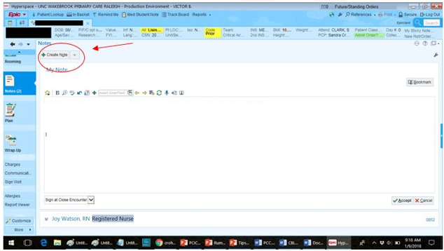
Student Workflow
The student begins the patient’s note in the encounter

Slide 18
Student Workflow
The student documents the history, physical exam, differential, and plan
Student pends an order for an x-ray
Student goes back into the chart to update the patient’s allergy list because the patient mentioned an allergy to azithromycin while talking to the teaching physician
The student must document their contribution to the visit, and sign the note with Name and Title (Medical Student)

Slide 19
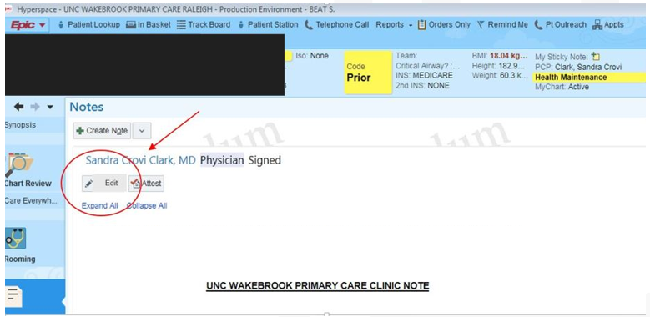
Teaching Physician Workflow
The teaching physician opens the note, clicks edit, and then uses Make Me the Author (MMTA) function

Slide 20
Teaching Physician Workflow
The teaching physician carefully reads the note and verifies the information
The teaching physician personally performs or re-performs the physical exam and medical decision making
The teaching physician edits the note to include only information verified by him
The teaching physician signs the pulmonology referral pended earlier by the student, edits, and then signs the note. The note now appears as the note of the physician. Contributions of the student can be seen by using the “hover” function

Slide 21
Attestation
The teaching physician must attest to their contribution to the encounter
The approved attestation is available in Epic@UNC under .ATTESTATIONUNCHCS
“I attest that I have reviewed the student note and that the components of the history of the present illness, the physical exam, and the assessment and plan documented were performed by me or were performed in my presence by the student where I verified the documentation and perform (or re-performed) the exam and medical decision making.”

Slide 22
Ending the Encounter
The medical student then reviews the note via the chart review function to learn from any edits or additions that the teaching physician included in the chart
The medical student noticed the teaching physician added some information in the physical exam section:
Gen: Speaking in long sentences and telling stories without any signs of respiratory distress.
Res: Diffuse expiratory wheezes throughout all lung fields.
The student realizes the information in the general exam section is important to include to show the patient was not in any respiratory distress during the visit. She also realizes her pulmonology exam documentation was not detailed enough

Slide 23
If an Attending and Resident are Both Involved in the Visit
The resident physician attests to their physical presence during the encounter. If applicable, the resident attests to reviewing the history and exam.
The attending physician attests to the applicable teaching guidelines i.e., being present for key and critical portions of the visit for the resident’s contribution.
The attending physician would also attest that they reviewed and updated the medical student documentation and that they personally performed or re-performed the physical exam and medical decision making.

Slide 24
Example – Clinical Case 2
Inpatient Hospital Experience

Slide 25
Chart Review, Patient Visit & Presentation
A medical student visits his patient in the morning before rounds, gets a history and performs a physical exam
The medical student presents the patient at the bedside. The teaching physician gets some additional details about the chest pain and examines the patient to confirm the physical exam findings presented by the medical student
Together they discuss the plan for the day

Slide 26
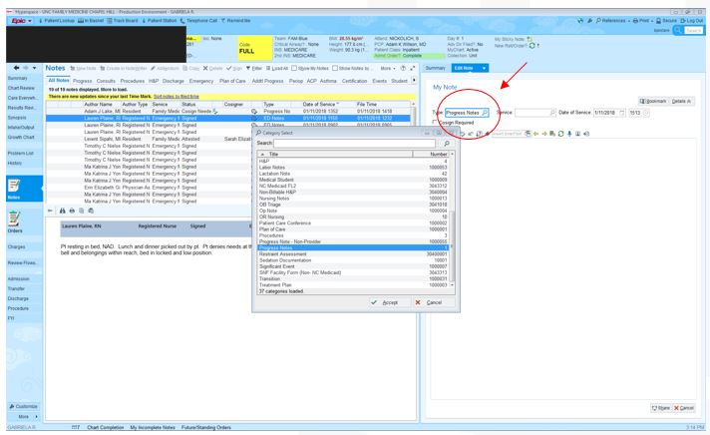
Student Workflow
The student selects the appropriate document type, in this case “Progress Note”

Slide 27
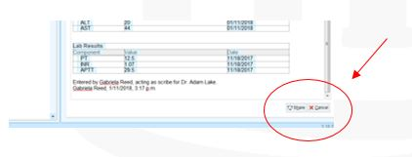
Student Workflow
The student writes the progress note including the history, physical exam, other relevant parts of the hospital course, and management plan
The student signs the note with Name and Title (Medical Student)
After completing the note, the student “shares” the note with the teaching physician
Once the note has been shared, all others using Epic will have access to view the note in the “Incomplete” tab

Slide 28
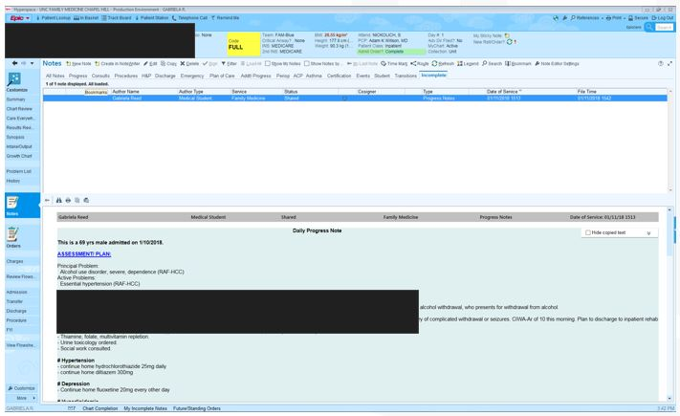
Teaching Physician Workflow
The teaching physician goes to the incomplete note tab and opens the note.
She reviews and edits the note. At this point the note will still appear to be a medical student note.

Slide 29
Teaching Physician Workflow
The teaching physician carefully reads the note and verifies the information
The teaching physician personally performs or re-performs the physical exam and medical decision making
The teaching physician edits the note to include only information verified by her
She signs the note. The note now appears in Epic as a physician note

Slide 30
Attestation
The teaching physician must attest to their contribution to the encounter
The approved attestation is available in Epic@UNC under .ATTESTATIONUNCHCS
“I attest that I have reviewed the student note and that the components of the history of the present illness, the physical exam, and the assessment and plan documented were performed by me or were performed in my presence by the student where I verified the documentation and perform (or re-performed) the exam and medical decision making.”

Slide 31
Ending the Encounter
Similar to the outpatient example, the medical student reviews the note after it is edited and signed by the resident to learn from any edits or additions that the teaching physician made

Slide 32
If an Attending and Resident are Both Involved in the Visit
The resident physician attests to their physical presence during the encounter. If applicable, the resident attests to reviewing the history and exam.
The attending physician attests to the applicable teaching guidelines i.e., being present for key and critical portions of the visit for the resident’s contribution.
The attending physician would also attest that they reviewed and updated the medical student documentation and that they personally performed or re-performed the physical exam and medical decision making.

Slide 33
Post Module Assessment
You have completed your online training; however, you are not done yet!
Once you return to the Learner tab, please follow the steps below for accessing the Required Assessment for full completion of your training: 1) Search for, “Medical Student Application Phase” in the search field located in the top right side of your Self home dashboard in LMS. 2) Find the Assessment within the Search Results in LMS and choose Register from the Select dropdown menu to the right of the activity. 3) Select the button in the bottom right of the NEXT screen to register for the Medical Student Application Phase Assessment. 4) Click the button on the top right of the NEXT screen to begin your Assessment.
Contact Epictraining@unchealth.unc.edu, if you encounter any problems accessing the assessment.

Slide 34
Lessons Learned
Students can contribute in important ways to patient care by documenting in the medical record.
Students must present findings from the history, physical exam, and assessment/plan in the physical presence of the attending or resident. Ideally the patient should be present during the presentation as well.
Teaching physicians must review and edit as necessary the student note and attest that the attending or resident verified the information in the note.

